Slide 1
Dart Lists

Slide 2
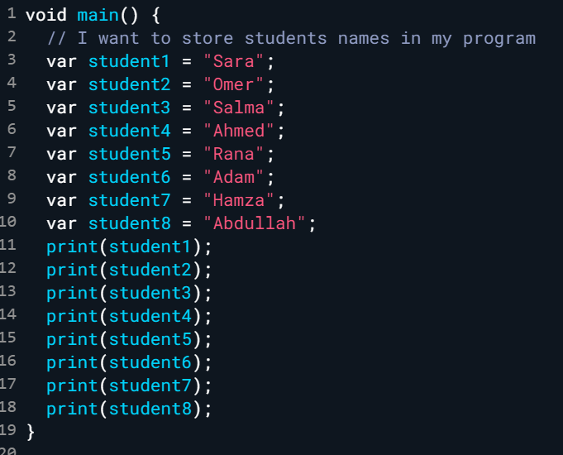

Slide 3
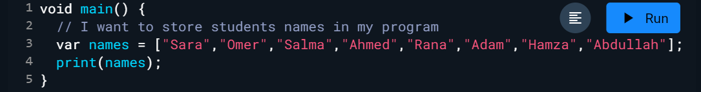
Lists are used to store multiple items in a single variable. which is the ordered collection of the objects. The array is the most popular and commonly used collection in any other programming language.

Slide 4
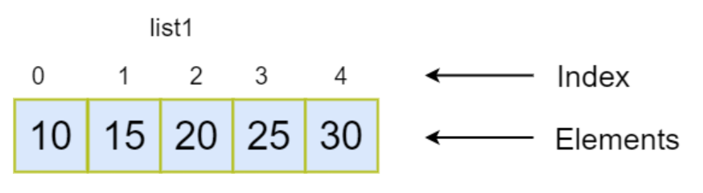
list1 - It is the list variable that refers to the list object.
Index - Each element has its index number that tells the element position in the list. The index number is used to access the particular element from the list. The list indexing starts from 0 to length-1 where length denotes the numbers of the element present in the list.
Elements - The List elements refers to the actual value or dart object stored in the given list.

Slide 5
Types of Lists
The Dart list can be categorized into two types :
Fixed Length List
Growable List
Let us now discuss these two types of lists in detail.

Slide 6
Fixed Length List
A fixed length list’s length cannot change at runtime. The syntax for creating a fixed length list is as given below:
Step 1 − Declaring a list:
var list_name = List<int>.filled(length,initial_value);
Step 2 − Initializing a list (if you want to change particular element)
list_name[index] = value;

Slide 7
Growable List
A growable list’s length can change at run-time. The syntax for declaring and initializing a growable list is as given below :
Step 1 − Declaring & Initializing a List
var list_name = [val1,val2,val3] ;
if you want to change any value you can using index to do this.
list_name[index] = value;

